Slide 1

Olist Store Analysis
Presented By Group-1
Sneha Vinchurkar

Slide 2

Introduction
01
02 Overview
03
KPI’s
04 Insights & Recommendations
Agenda
05
Conclusion

Slide 3

The Olist Store Analysis project aims to analyze customer purchasing patterns and payment statistics on an E- commerce platform, Olist. This project covers several key performance indicators (KPIs) such as weekday vs weekend sales, payment statistics, delivery time, and customer behavior. The analysis is based on nine CSV files, which are cleaned and manipulated to extract valuable insights.
Over View

Slide 4

Weekdays and weekend payment statistics
Payment Type with review score 5
Average numbers of delivery days taken for pet shop
Average price and payment value of sao paulo city
Average shipping days vs review scores
KPI’s

Slide 5
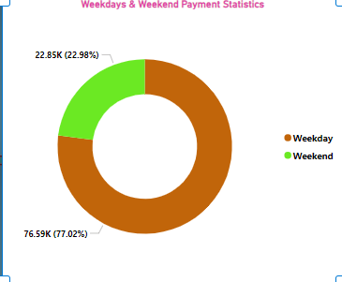
Weekday vs Weekend payment statistics
KPI 1
Weekday Vs Weekend (order_purchase_timestamp) Payment Statistics
The analysis of payment statistics based on weekday vs. weekend provides an understanding of the buying behavior of customers. This KPI answers questions like, which day of the week has the highest sales?
How many customers prefer to pay through online modes? The analysis of this KPI can help Olist to improve their weekend sales and plan promotions accordingly.

Slide 6
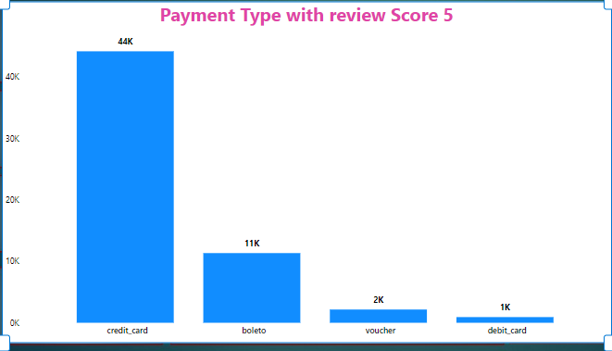
Payment Type with review score 5
KPI 2
Number of Orders with Review score as 5 And payment type as Credit card
This KPI analyses the number of orders with a review score of 5 and payment type as credit card. This helps in understanding customer satisfaction levels and payment preferences. Olist can use this information to identify satisfied customers and encourage them to make repeat purchases

Slide 7
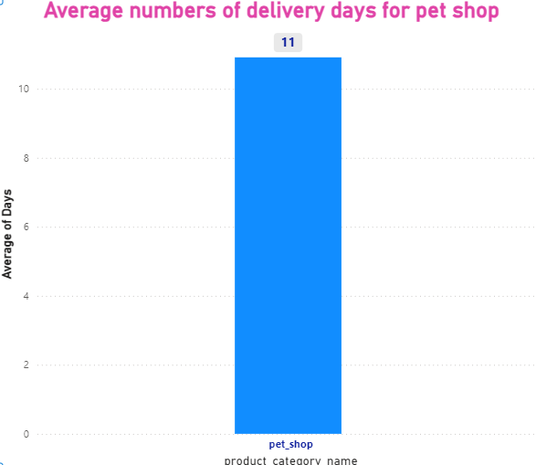
Average numbers of delivery days taken for pet shop
KPI 3
Average number of days taken for order_delivered_customer_date for pet_shop
This KPI analyzes the average number of days taken for order_delivered_customer_date for pet_shop. It helps Olist in identifying areas where they can improve their delivery time and maintain customer satisfaction.

Slide 8
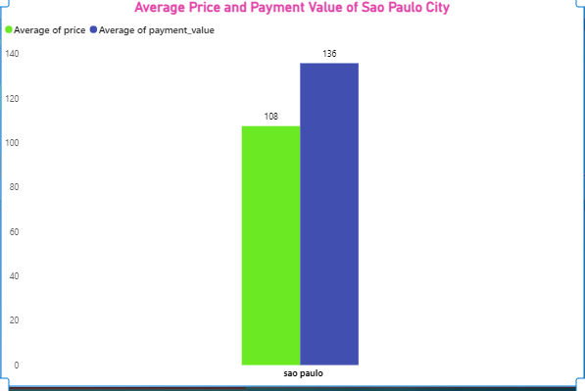
Average price and payment value of sao paulo city
KPI 4
Average price and payment values from customers of sao paulo city
The analysis of average price and payment values from customers of Sao Paulo city helps in understanding the spending patterns of customers in this region. It also helps Olist in identifying high-value customers and creating targeted marketing campaigns.

Slide 9
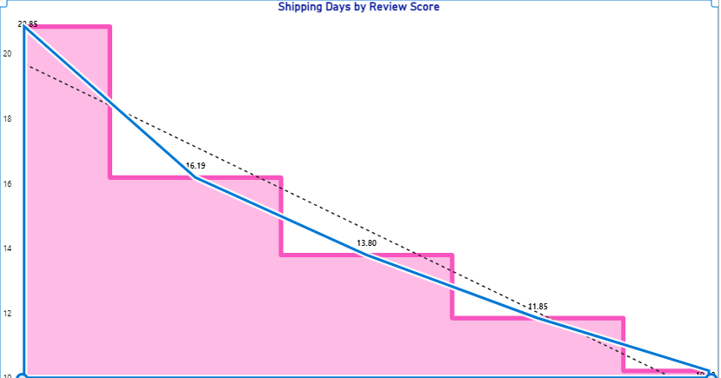
Average shipping days vs review scores
KPI 5
Relationship between shipping days (order_delivered_customer_date — order_purchase_timestamp) Vs review scores
This KPI analyzes the relationship between shipping days and review scores. It helps in understanding the impact of delivery time on customer satisfaction levels. Olist can use this information to optimize their logistics and improve their delivery time.

Slide 10
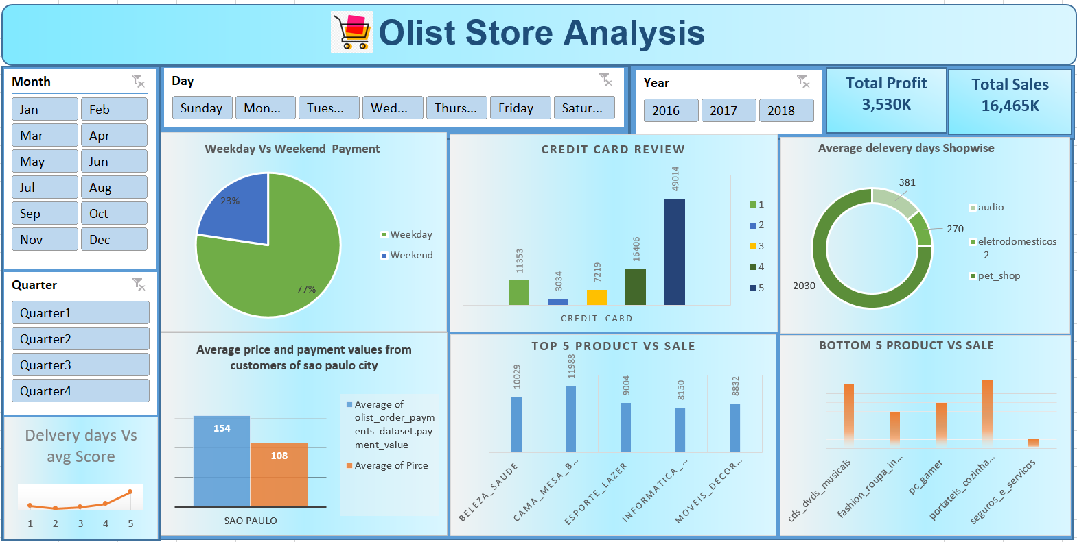
Olist Excel Dashboard

Slide 11
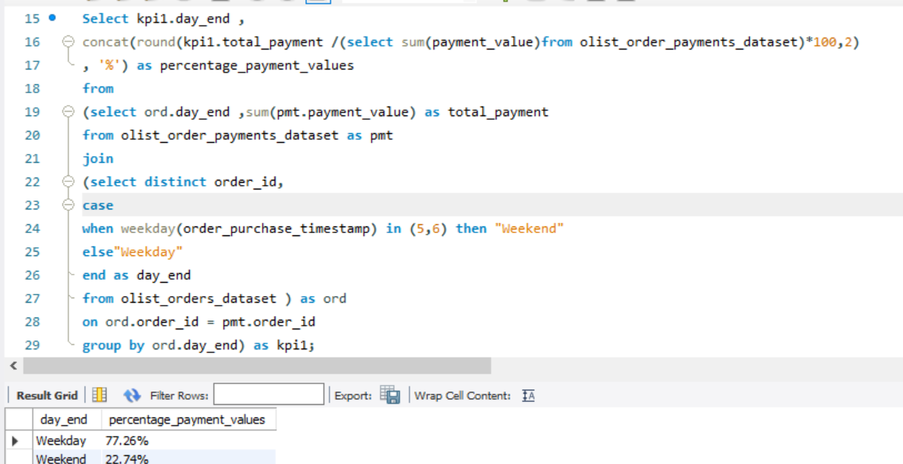
SQL Analysis for KPI 1

Slide 12
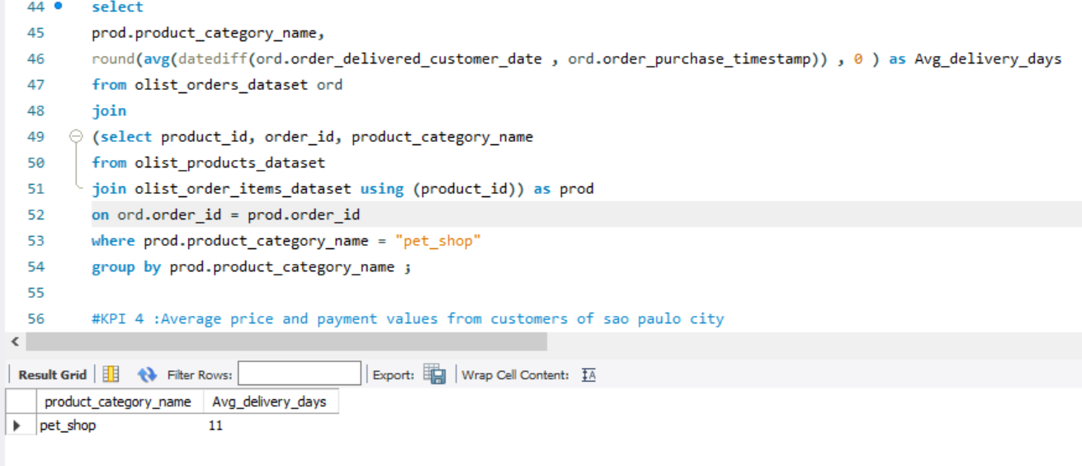
SQL Analysis for KPI 2

Slide 13
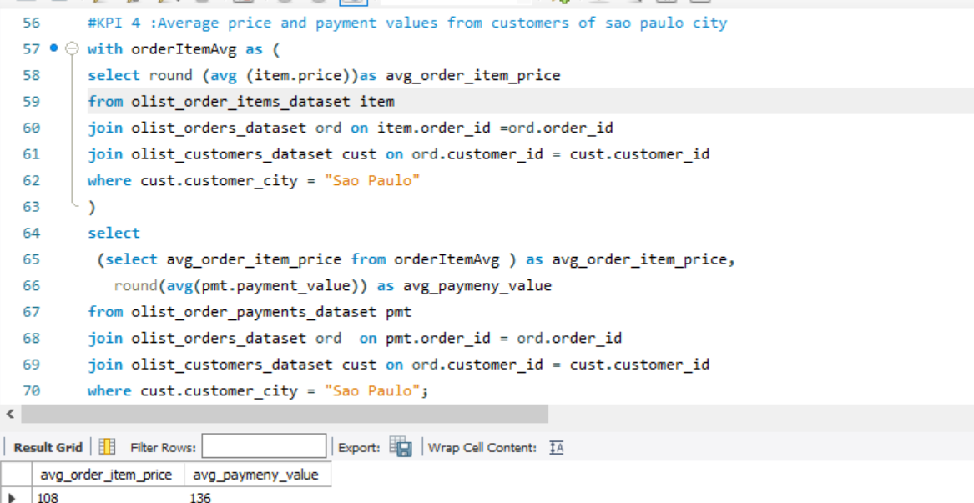
SQL Analysis for KPI 3

Slide 14
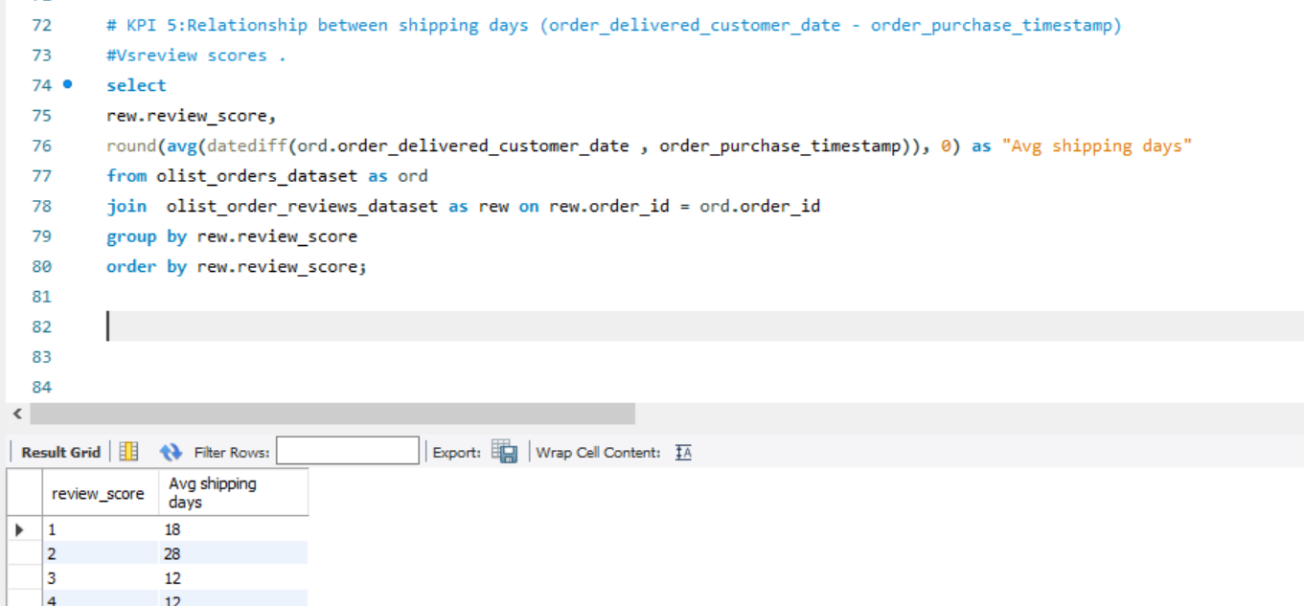
SQL Analysis for KPI 4

Slide 15
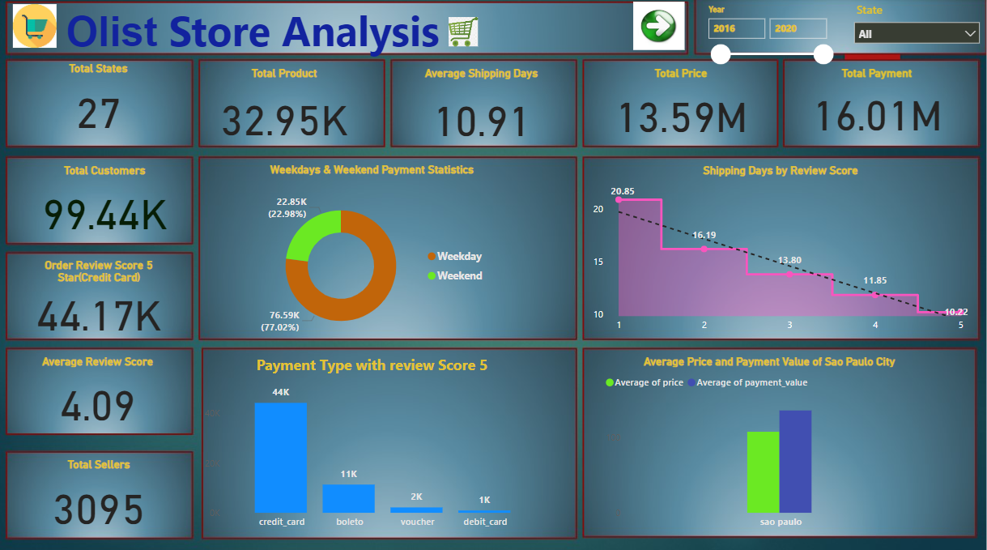
Olist Powerbi Dashboard 1

Slide 16
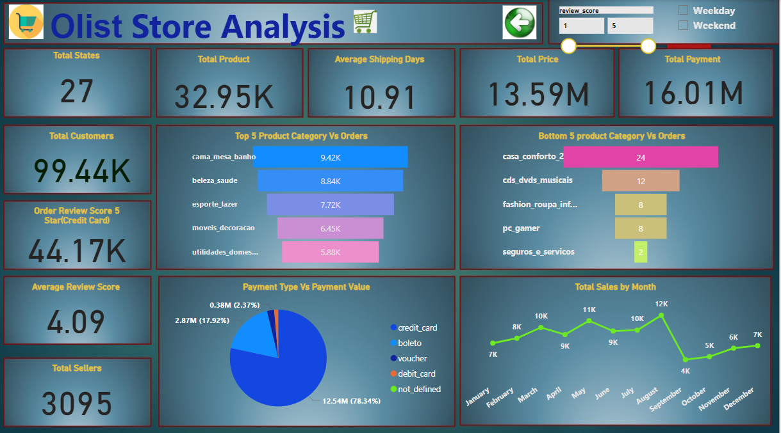
Olist Powerbi Dashboard 2

Slide 17
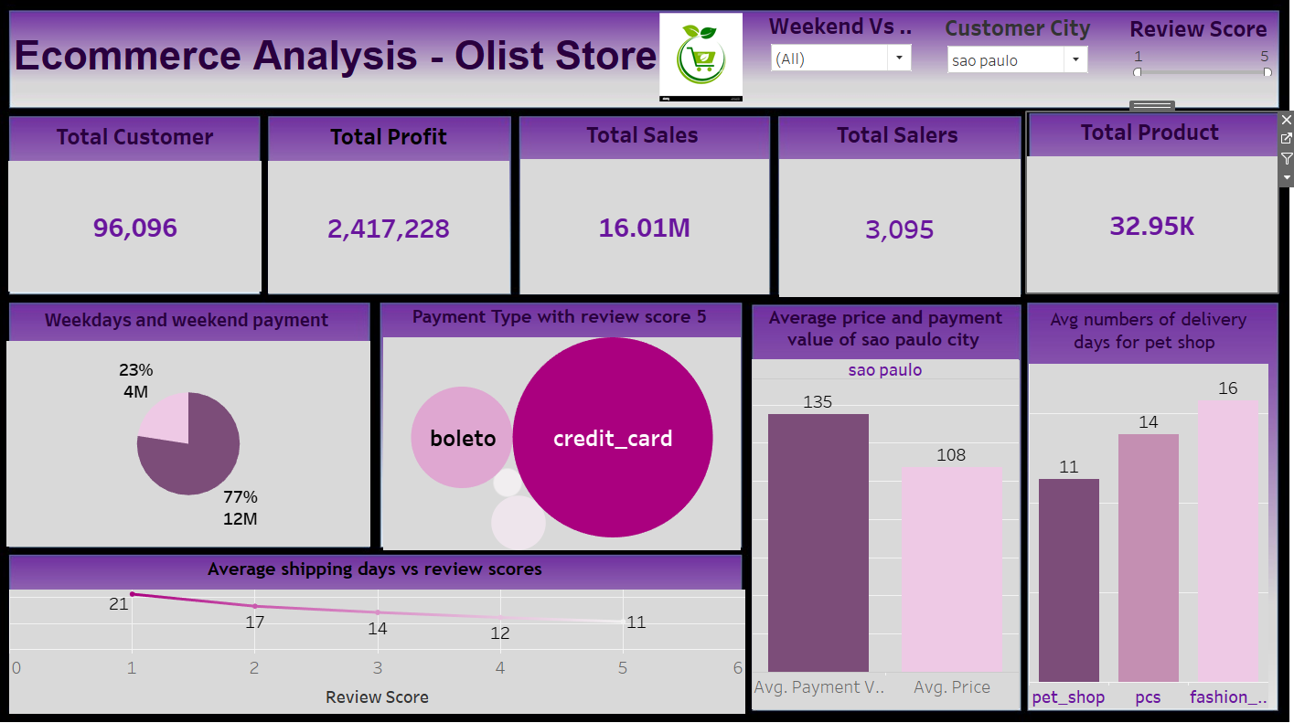
Olist Tableau Dashboard

Slide 18

Insights from this analysis can help in making business decisions, such as focusing on products that customers are interested in, improving product and service quality, and optimizing marketing in provinces with high total sales. In addition, this analysis also provides an overview of customer consumption trends and patterns that can be used to direct further business strategies.
Insights

Slide 19

Regularly monitor and analyze customer reviews to gain insights in product quality and identify areas for improvement. Dashboards can be used to identify patterns in customer reviews.This will provide a data-driven approach to enhance customer experience.
Recommendations

Slide 20

Overall, regular monitoring of customer reviews, real- time tracking of fleet performance, together with proper shipment tracking and communication system can improve Olist's delivery and supply chain performance and ensure customers are highly satisfied with the service.
Summary

Slide 21

The Olist Store Analysis project provides valuable insights into customer behavior and payment statistics. The analysis of these KPIs helps Olist in identifying areas of improvement and creating targeted marketing campaigns. As a data analyst, I have used Excel and Power BI to clean and manipulate the dataset and create meaningful visualizations. This project serves as a great example of how data analysis can help businesses make informed decisions.
Conclusion

Slide 22





